Slide 1
The Elusive Internet Flattening: 10 Years of IXP Growth
T. Böttger¹, G. Antichi¹, E.L. Fernandes¹, R. Lallo²³, M. Bruyere⁴, S. Uhlig¹, I. Castro¹
¹QMUL ² Roma Tre University ³Consortium GARR ⁴University of Tokyo

Slide 2
Spoiler
IXP evolution:
Large growth: # IXPS and members tripled in 2008-2016
Reachability stagnation: % IPv4 addresses reachable through IXPS has stabilised around 80%
Macroscopic impact?
Little path-shortening: not one-hop away
Hierarchical flattening: less transit dependence

Slide 3
NAP
Tier 1 access provider
Tier 1 access provider
Regional access provider
Regional access provider
The early Internet
Local access provider
Local access provider
Hierarchical early Internet

Slide 4
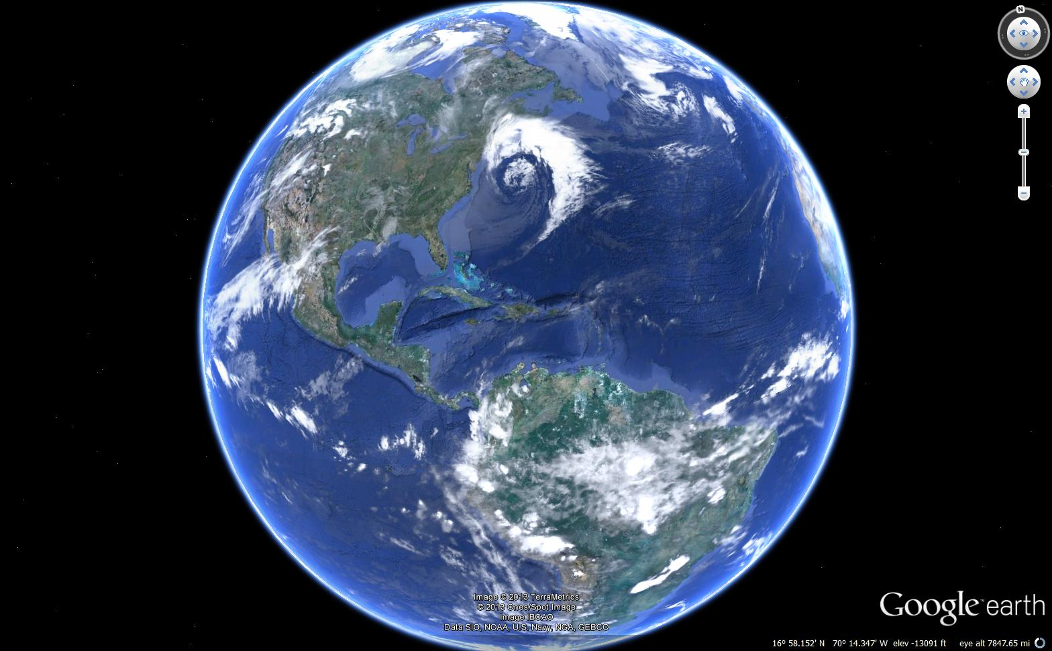
IXP
Local access provider
Local access provider
Very few hops, LESS HOPS than ever, we will make no hops at all!!! Trust me!!! #Internetisflat #lesshops
There is LESS TRANSIT DEPENDENCE, in fact the least transit dependence ever!!! #Internetisflat #lesstransit

Slide 5
IXPs matter for individual ASes
Macroscopic impact???
Internet flattening

Slide 6
Flattening: Shorter paths?
4
3
5
2
2
1
1
6
Very few hops, LESS HOPS than ever, we will make no hops at all!!! Trust me!!! #Internetisflat #lesshops
Many hops
Hierarchical-early Internet
Flattened-modern Internet

Slide 7
Flattening: less transit providers?
3
2
1
4
Large transit dependence
There is LESS TRANSIT DEPENDENCE, in fact the least transit dependence ever!!! #Internetisflat #lesstransit
Hierarchical-early Internet
Flattened-modern Internet

Slide 8
Are there that many IXPs to “flatten” Internet paths??
Historical growth of IXPs:
Number
Size
Reachability

Slide 9
Data
IXPs and IXP membership data:
PeeringDB 2010-2016: CAIDA (https://www.caida.org/data/peeringdb/)
PeeringDB 2008-2009: “Wayback Machine” (http://archive.org/web/)
AS-relationships (and T1s):
2006-2016: CAIDA (http://www.caida.org/data/as-relationships/)

Slide 10
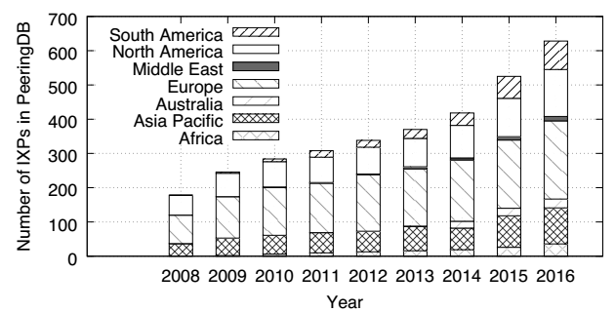
Large IXP growth over time
Big stay big
Rise of new regions
In number of IXPs

Slide 11
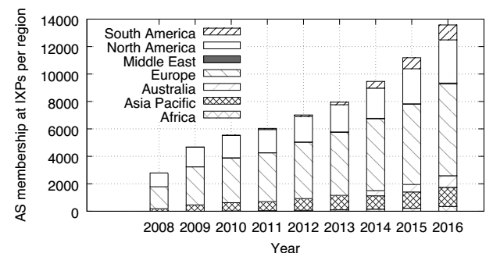
Large IXP growth over time
Big stay big
Europe tops growth
Rise of new regions
In number of IXPs
In number of ASes/members

Slide 12
What about reachability?

Slide 13
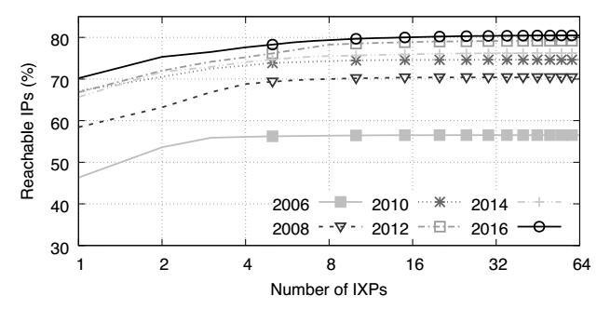
~80% of announced IP’s are reachable via IXPs
100% IPs =
IPs reachable through T1s
(approx. 99% of the IP space)
IPv4 reachability =
IPs that an AS could reach by collocating at an IXP and peering with all its members (T1s excluded)

Slide 14
~80% of announced IP’s are reachable via IXPs
Stagnation around 80%
few IXPs are enough (for reachability )

Slide 15
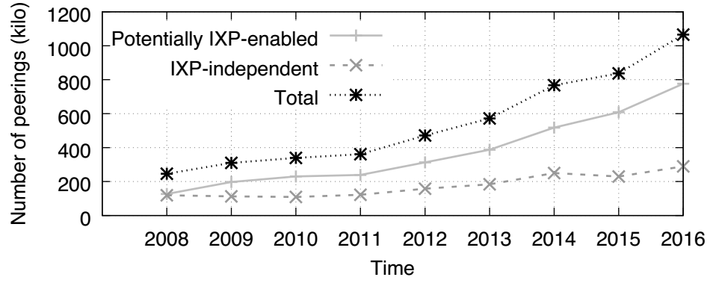
Large growth of potential peerings at IXPs
Potential peering if 2 ASes are:
peering (CAIDA)
Colocated (PeeringDB)

Slide 16
Large growth of potential peerings at IXPs
Most peering growth is (potentially) IXP-enabled

Slide 17
How & how much do IXPs matter?
Historical impact of IXPs on Internet paths:
how much have Internet paths “flattened”?
Reduction of path lengths?
Reduced transit dependence?

Slide 18
Data & Methodology
Traceroute data (monthly snapshots)
iPlane (2006 -2016): from PlanetLab nodes, 2.3 billion traceroutes
CAIDA Ark (2007-present): from Ark monitors, 4.4 billion
Sanitization of traceroutes (358M Ark, 1.1 billion iPlane)
destination IP required
≥ 1 unresolved IP-hop
≥ 1 IXP
Identification of IXPs:
G. Nomikos & X. Dimitropoulos. “traIXroute: Detecting IXPs in traceroute paths”. PAM 2016

Slide 19
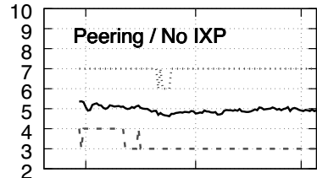
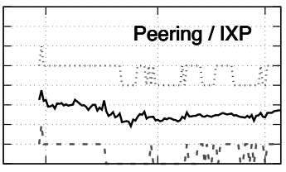
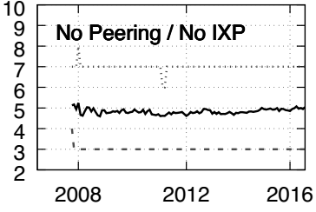
Path length stability
Path-length is stable out of IXPs
IXPs enjoy a small path-length reduction
IXPs have slightly shorter path lengths

Slide 20
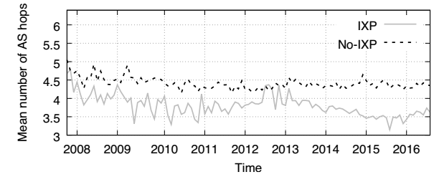
Some path-shortening for very large networks
15 “Very large large networks”: T Boetger et al., “Looking for Hypergiants in PeeringDB”, ACM CCR 2018

Slide 21
How meaningful are path-lengths?
Emergence of remote peering:
IXP
AS

Slide 22
How meaningful are path-lengths?
Emergence of remote peering:
Remote peering provider
IXP
AS

Slide 23
How meaningful are path-lengths?
Emergence of remote peering:
Since (at least) 2014 most IXPs have remote peers (Castro et al, CoNEXT 2015)
On going trend (Nomikos et al, IMC 2018)
CDN redirecting (e.g., Netflix, Castro et al. 2018)
Path-length does not (necessarily) correlate with performance
Impossible to know the traffic volumes corresponding to each route
No vantage point in the Internet has full visibility

Slide 24
How & how much do IXPs matter?
Historical impact of IXPs on Internet paths:
how much have Internet paths “flattened”?
Reduction of path lengths?
Reduced transit dependence?

Slide 25
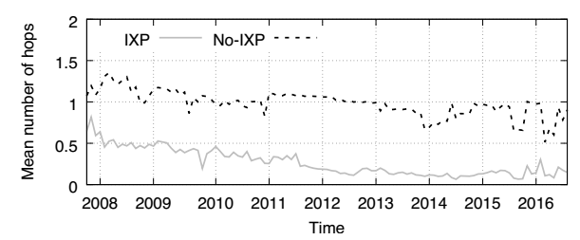
Hierarchical flattening: less T1s
Decreasing T1s over time
Less T1s in IXP paths
Notes:
“Very large Networks” or hypergiants:
Apple, Amazon, Facebook, Google, Akamai, Yahoo, Netflix, Hurricane Electric, Twitter, Twitch, Cloudflare, Microsoft, Limelight, Verizon (as defined in T. Böttger et al., “Looking for Hypergiants in PeeringDB”. CCR 2018)

Slide 26
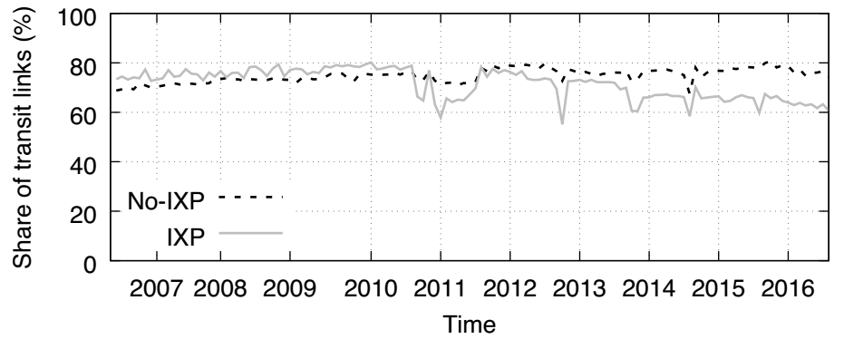
Hierarchical flattening: less transit links
CDNs?
From 2011/2012:
Decreasing % of transit links at IXPs
Less transit links in IXP paths
Notes:
Calder et al (IMC 2013), Google rapid geo-expansion from 2013
Netflix CDN announced in 2012

Slide 27
A small number of ASes still play a central role
Ranked in terms of traces traversing an AS
Divergence in customer cone sizes over time
Divergence vanishes for less central networks
Most central ASes are large & NOW avoid IXPs
Avg. customer cone size (thousands of ASes)
AS size in terms of reachability/customer cone
Least central ASes are small & “like” IXPs
Traces separated depending on whether they traverse and IXP or not

Slide 28
Next things to look at
More data/data bias
CDN emergence
Specific impact of IXP emergence on reduced transit dependence:
Local benefit of creating an IXP (and its growth)
Local benefit of the creation of abroad IXPs
Model/predict the emergence/growth of IXPs
Current draft: https://arxiv.org/abs/1810.10963

Slide 29
Questions?
Thoughts?
…
i.castro@qmul.ac.uk

Slide 30
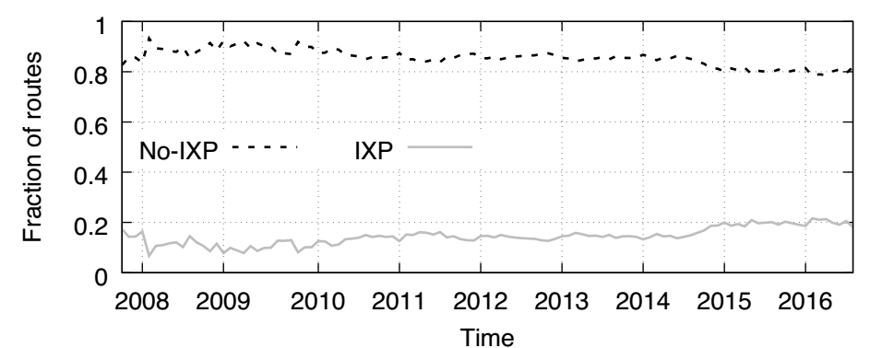
More traceroutes traverse IXPs
About the double

