Slide 1
RIPE 78 Reykjavík Iceland 20-24 May, 2019
Host welcome speech
Örn Orrason
VP Sales & Business Development

Slide 2
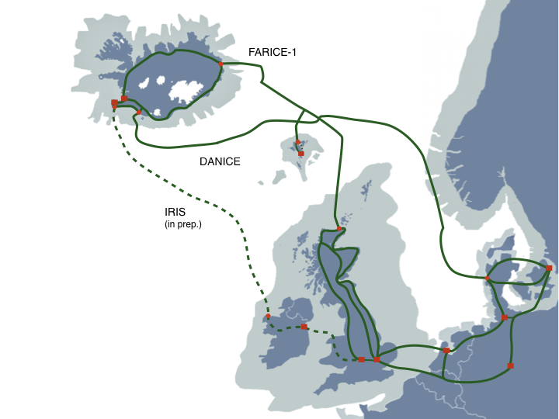
FARICE-1 (2004)
DANICE (2009)
IRIS (in preparation)
Circuits from 100MbE to 100GbE
IPT (BGP) services
Customers are service providers and DC customers
STM-1 (2004) costs same as 4x10 Gb/s (2019)
(57% CAGR)

Slide 3
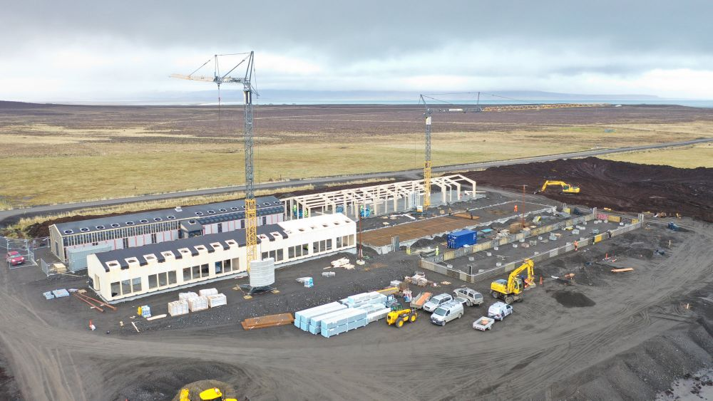
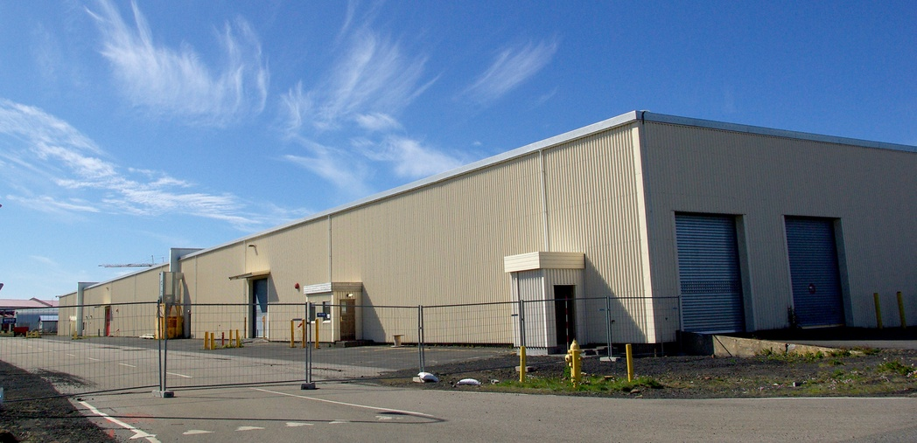
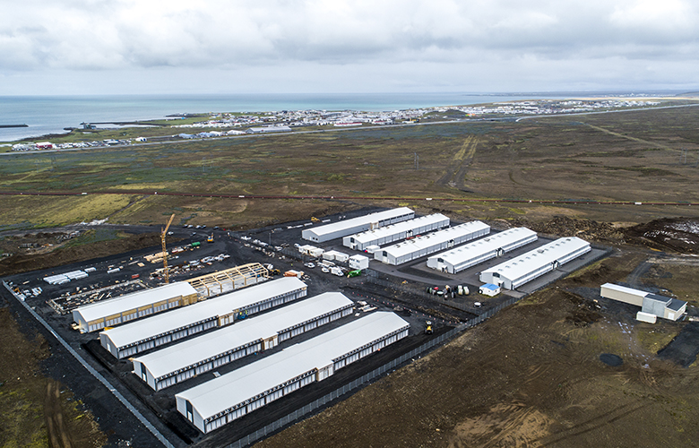
Iceland has only clean energy (hydro and geothermal)
Fast growing DC industry
Well suited for power intensive HPC appliations
Financial and automotive sectors for example

Slide 4
High speed networks with early fiber deployment
Early adopter of FTTH
80% of residential houses connected in 2019
2025 100% coverage expected
All rural areas covered end of 2021with fiber (6000 sites)
State funded deployment

Slide 5
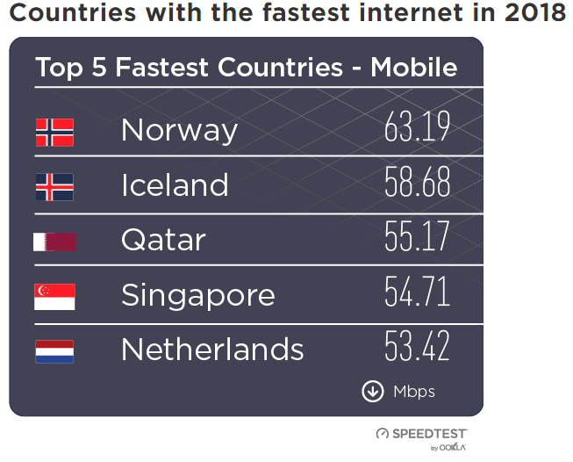
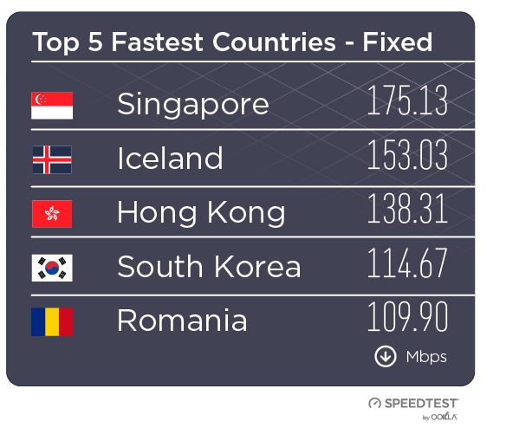

Slide 6
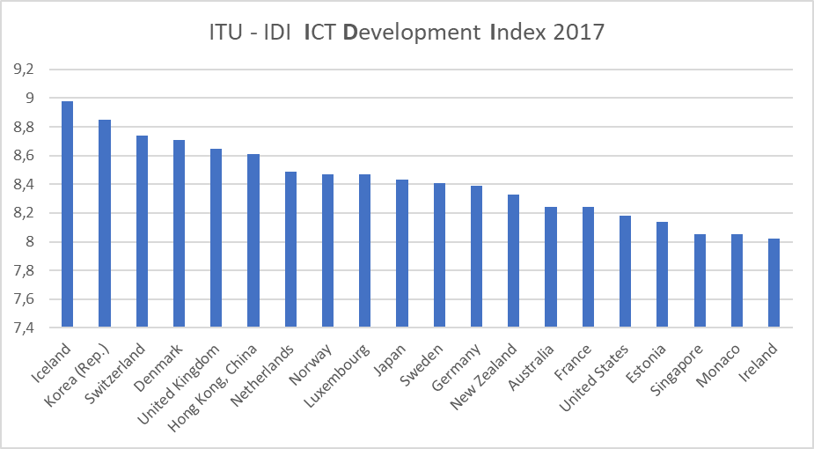
Iceland ranks #1 on ITUs ICT Development Index

Slide 7
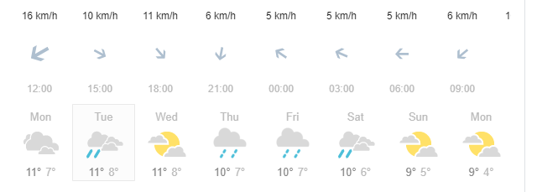
Calm weather so enjoy your stay !

Slide 8
T- Shirts give away in the coffee break 15:30

