Slide 1
Five Years at the Edge:
Watching Internet from the ISP Network
Danilo Giordano, Martino Trevisan, Idilio Drago, Marco Mellia, Maurizio Munafò

Slide 2
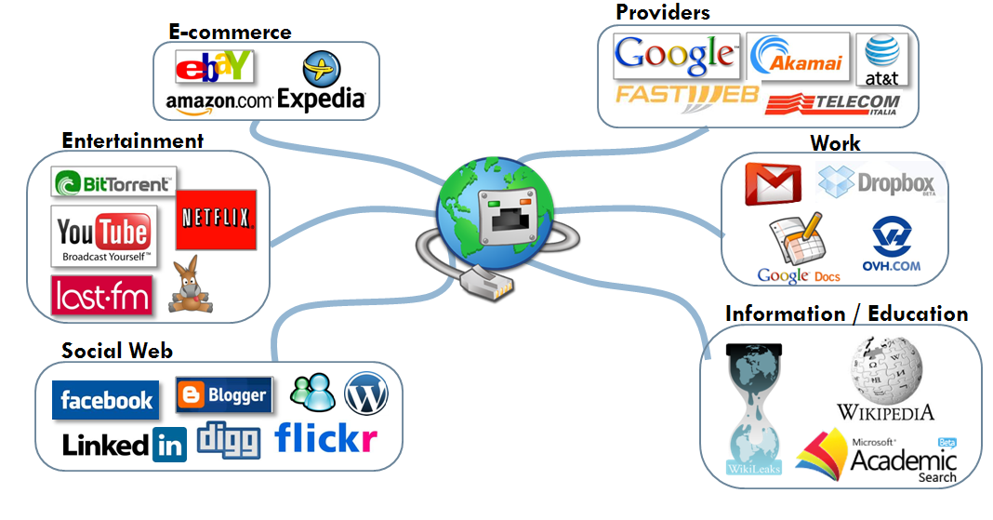

The Goals
“The Internet is the first thing that humanity has built that humanity doesn't understand, the largest experiment in anarchy that we have ever had.”
Eric Schmidt – ex Google Exec. Chairman

Slide 3
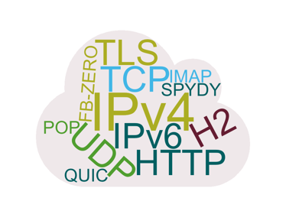
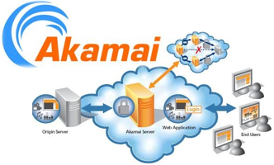
The Questions
How much does the user cost?
How users' habits changed?
How the protocols changed?
How the infrastructure changed?

Slide 4

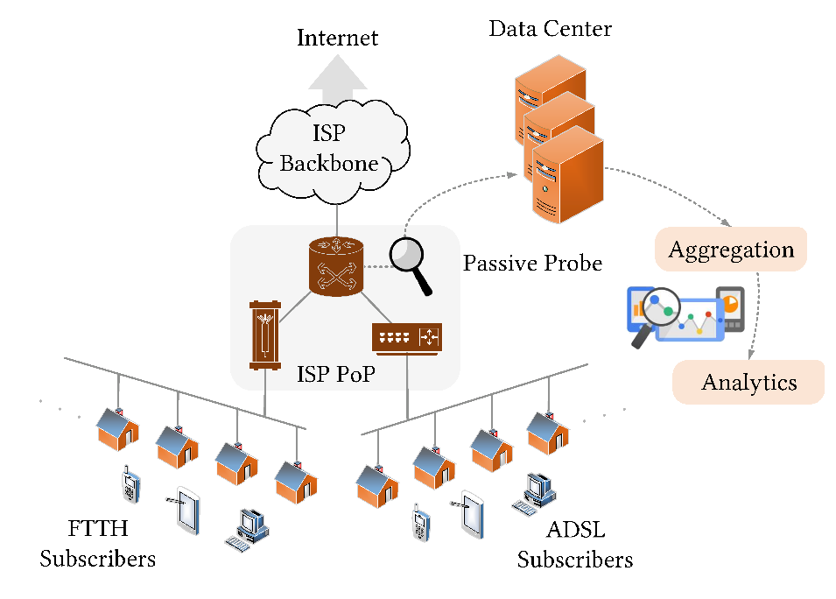
Measurement Setup
5 Years 04/2013 – 10/2017
247 Billions flows
31.9 TB of compressed data
*Data at https://smartdata.polito.it/five-years-at-the-edge-watching-internet-from-the-isp-network/
5 k households
Download 100 Mbps Upload 10 Mbps
10 k households
Download 4-20 Mbps Upload 1 Mbps

Slide 5
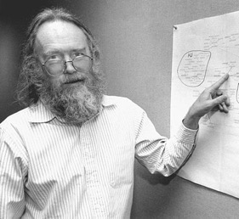
Measurement Setup
5 Years 04/2013 – 10/2017
247 Billions flows
31.9 TB of compressed data
  Process traffic in real-time
      Statistics computed at the end of the flow
  Implements DN-Hunter
      To Track DNS conversations
      To tag the network flows with the FQDN
When | FQDN
Current | facebook.com, fbcdn.com
Before | fbstatic-a.akamaihd.net
“A name indicates what we seek.
An address indicates where it is.
A route indicates how we get there.”
Jon Postel – RFC 791
Regexp* | Service
facebook.com, fbcdn.com, ˆfbstatic-[a-z].akamaihd.net$ | Facebook
netflix.com, nflxvideo.net | Netflix
*Full list at https://smartdata.polito.it/five-years-at-the-edge-watching-internet-from-the-isp-network/
FQDN
Facebook.com
Service
Facebook
HTTP Host:
--
c_ip | c_port | c_pkts | c_bytes | s_ip | s_port | s_pkts | s_bytes | Protocol
12.132.54.94* | 1197 | 1 | 18938 | 87.250.137.92 | 443 | 1 | 992221 | HTTP
TLS/SNI
Facebook.com
*Client IP address is anonymized
Tstat
DN-Hunter

Slide 6
1. How much does the user cost?

Slide 7
Daily Traffic Consumption
  CCDF of Daily traffic consumption per household
  FTTH vs ADSL
    25% + Download, 2x Upload
  CCDF of Daily traffic consumption per household
  2014 vs 2017
    ADSL 2x Download and Upload
Download
Upload
Heavy Upload
Notes:
Complementary Cumulative Distribution Function

Slide 8
2. How users' habits changed?

Slide 9
Service Popularity
% of active households accessing a given service
  Only Real Visits
15 % ➔ 45 %
0.3 % ➔ 0.3 %

Slide 10

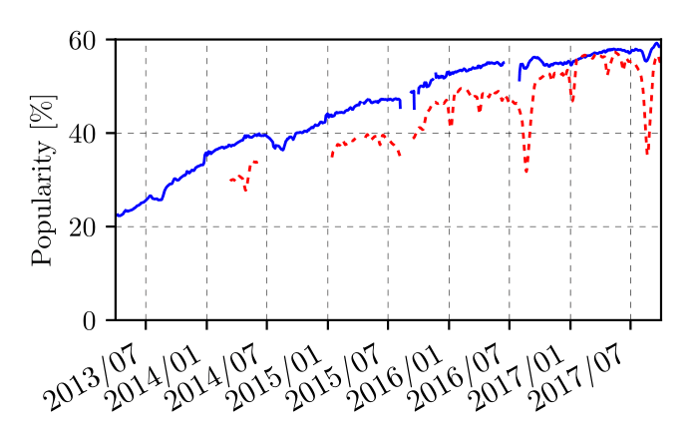
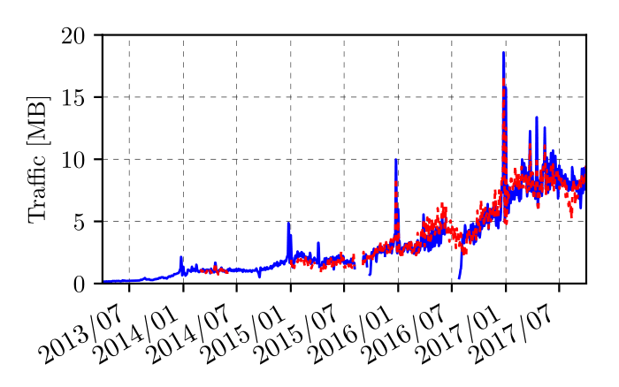

What is the traffic load imposed by web services?
Popularity almost reached saturation
Per-user traffic now 10 MB per day
  Christmas and New Year’s Eve peaks

Slide 11
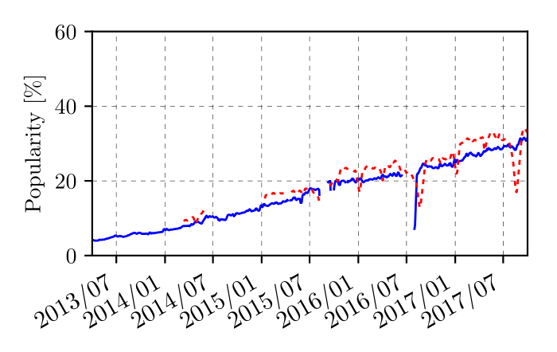
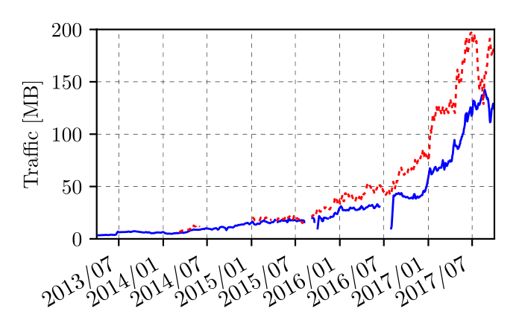
What is the traffic load imposed by web services?
Popularity still growing
Per-user traffic still exploding
WhatsApp and Instagram are mostly used from mobiles
Those are taking a predominant role also at home

Slide 12
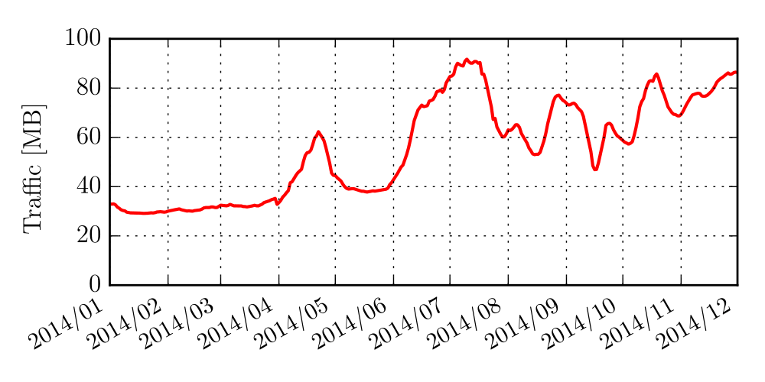
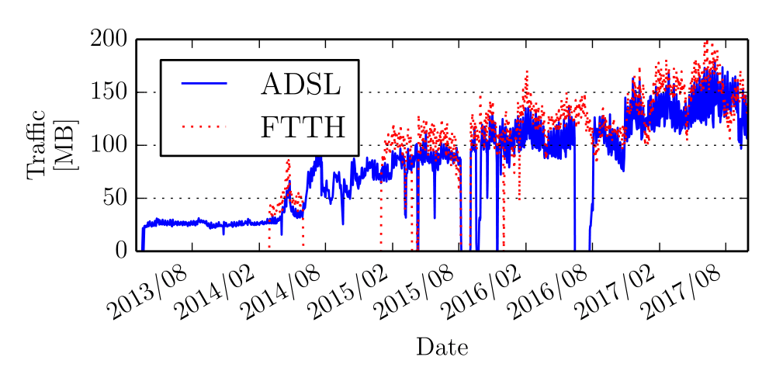

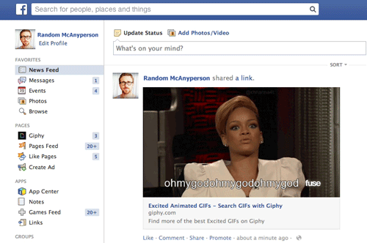
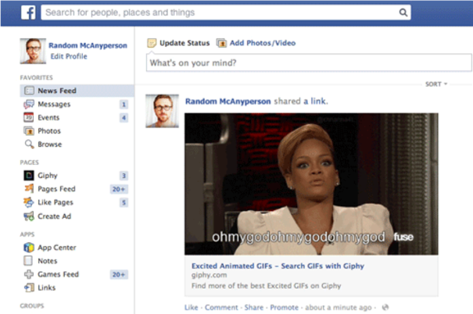
What is the traffic load imposed by web services?
Average traffic per-client per day
Video auto-play enabled in 2014
  April traffic from 35 MB to 60+ MB
  After video auto-play stopped
  July daily traffic topped at 90 MB
    2.5 times March 2014!
Big players owning servers and clients
can dramatically impact traffic consumption
complicating the management of ISP networks

Slide 13
3. How the protocols changed?

Slide 14
Web Protocols Over Five Years
Traffic share for several Web protocols
  Google Disabled QUIC
  YouTube from HTTP to HTTPS
  Google start QUIC
  Probe updates to identify SPDY
  SPDY traffic to HTTP/2
  FB-Zero deployment
Big players owning servers and clients
are free to deploy experiments on the web
complicating the network management
90%
25%

Slide 15
4. How the infrastructure changed?

Slide 16



CDN Monitoring Methodology
…Because access delay is negligible…
… right?
Study CDNs impact
  Content access latency as Users’ Quality of Experience metric
    Focus on the Round Trip Time (RTT)
RTT from the probe to servers only
  Core Network Delay
Excluding RTT from clients to the probe
  Access network delay
syn
RTT
Syn,ack
Core network delay
Access network delay

Slide 17

The birth of the sub-millisecond Caching
The CDN is inside the PoP!
Compare RTT Distributions
  April 2014 vs April 2017
🙂
🙁
🙂
😃
0.37
CDNs are making sub-millisecond internet possible
New headache for the ISPs: host/manage CDNs inside their network
3
20
0.5
3

Slide 18
Conclusion & Future Work
Q1: Households daily traffic more than doubled
Q2: Quick rise of social applications
  Able to generate massive amount of data
Q3: Big players experiment new protocols (& imposing standards)
Q4: The infrastructure keeps concentrating and specializing
Current and Future Work
  Web portal to make this data playable
  New analytics for…

Slide 19


Slide 20
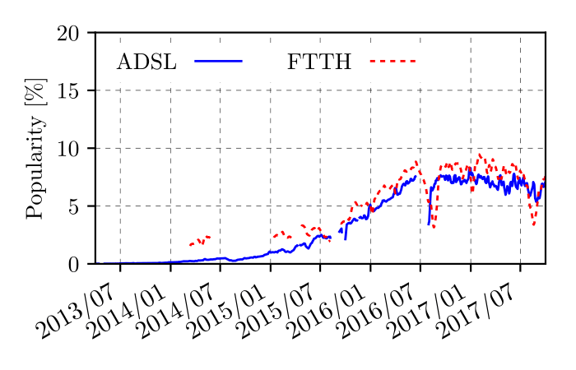
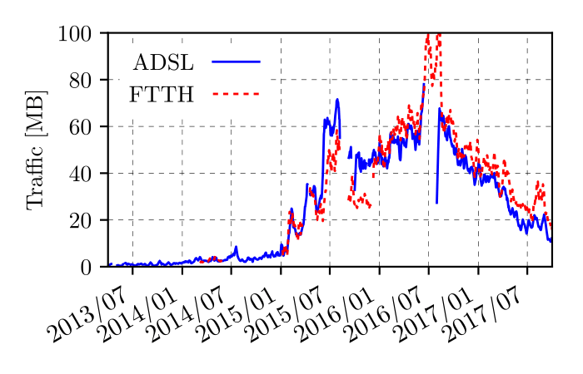
What is the traffic load imposed by web services?
Popularity tops in 2016
Per-user traffic drops mid 2016

Slide 21
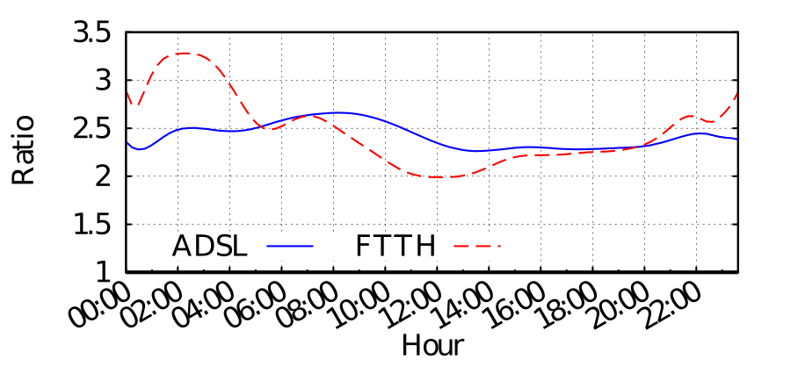
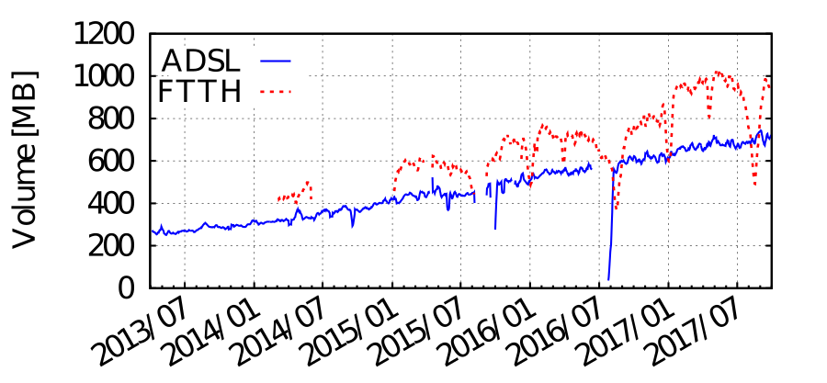
Traffic Consumption Increase
Average download per user per day
  Increases at constant rate
Does it hold at every hour of the day?
Yes!
  Late night traffic increases
    automatic download of updates, machine-generated traffic like IoT devices
    Larger for FTTH due to different profiles
  During prime time FTTH has a higher increase
    Video streaming content in higher definition
The same user consume twice the traffic

Slide 22
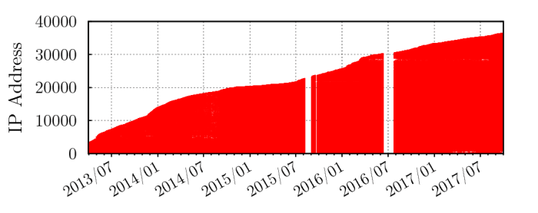
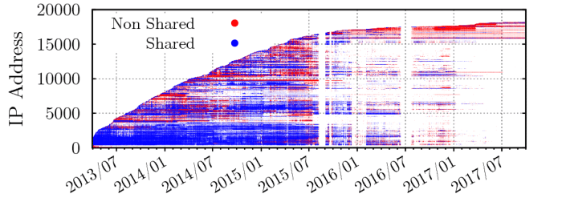
The Server Infrastructure
Server IP evolution over time
  Red: the IP address was dedicated
  Blue: the IP address
  no dot: the IP address was not contacted in that day
  Always used a totally dedicated infrastructure
  In 2015 starts migrating to a dedicated infrastructure

Slide 23
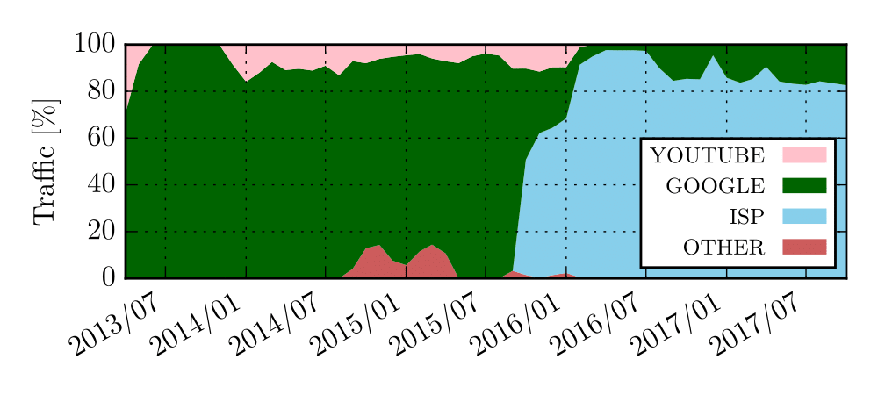
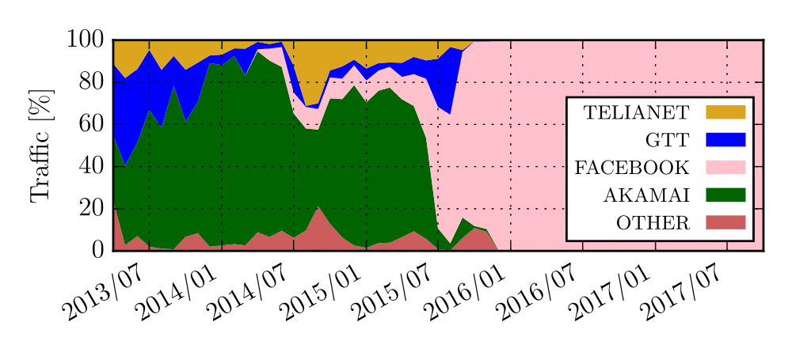
The Server Convergence
Which Autonomous Systems are involved?
  YouTube PoP integration during 2015
    Migration to Facebook infrastructure started in 2014 ended in 2015
Content providers deploy their own infrastructures
with thousands of IP addresses

