Slide 1
Faucet : Openflow SDN Made Easy
Richard Nelson
RIPE78
Notes:
What is SDN?
Faucet reduces SDN problem domain to solve the problem of how to use it easily

Slide 2
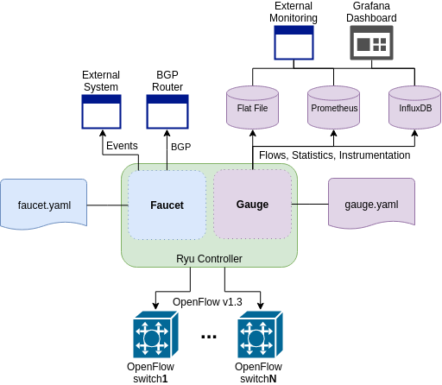
Faucet is an Enterprise SDN Controller
Notes:
Enterprise in this case mostly means that it doesn’t implement MPLS or other WAN protocols.
It also means lots of mostly copper ports , multiple speeds and many wireless APs. Hard to design a standard build-out.
Lots of fine grained security and policy to be applied - no control over edge devices.
Faucet does layer 2 and 3.
It has a companion app that provides monitoring and statistics.
Production networking
Feature set
Testing
Implements useful primitives that can be built on top of
Forwarding, VLANs, ACLs, L3 FIB
Implement some additional protocols for interop
BGP, Stacking, LACP, ARP & IPv6 ND
Protocols modular so they are only turned on when configured

Slide 3
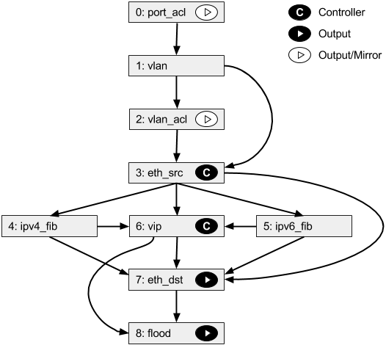
Faucet Pipeline
Notes:
Faucet has a pipeline.
Uses multi-table Openflow 1.3
Pipeline is designed to implement the core functionality of Faucet. It is not customised to the hardware.
Maximum possible pipeline.
Tables are only created on switches if they are required to implement the features that have been configured into Faucet.
Does not have any driver code
Enables true multi vendor networking - as long as vendors have support because we will not support their hardware

Slide 4
Integration Test Suite
Boot up many different network scenarios in parallel
30 - 60 minutes to complete
More code than the controller
Ensure features work and checks performance
Open vSwitch reference
Real hardware
Lets us prequalify devices for FAUCET support
Cyber RFP
Notes:
To put software into production networks people have to be convinced it is reliable. The best way to convince people is to actually be reliable.
Faucet has extensive testing to do that.
Unit testing using standard python framework with high code coverage.
Integration tests to deploy Faucet in a wide range of configurations against switches
Uses OpenVSwitch reference implementation to check that Faucet works.
Then can be deployed against hardware switches to see that they implement OF correctly.
This means that buying compatible hardware requires no reading of specs or features but simple deployment of an automated process. To date six vendors have supplied hardware to pass the tests
Cyber-RFC - Stephen Stuart announced at FaucetCon and OVS Fall Conference. Now a requirement for selling OF switches to Google enterprise
Google code not released. They use the Faucet test suite to check switches before purchase.

Slide 5
Switch Support
Notes:
Cisco Catalyst 9300 Series Switches, Cisco IOS XE Fuji 16.9.x
OpenFlow 1.3 Multitable—Enables integration with open source Faucet SDN Controllers to automate management of layer 2 switching, VLANs, ACLs, and layer 3 routing

Slide 6
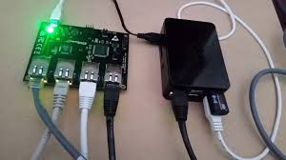
As simple as possible (but no simpler)
Easy to Install
pip, apt, docker etc
Easy to Configure
YAML
Easy to Automate
Test, deploy on green
Easy to Upgrade
Weekly releases
Well Documented
https://docs.faucet.nz
Notes:
Faucet is easy to use.
It is packaged for Debian/Ubuntu and docker. Also there are Raspberry Pi images and you can install from Pip
Configuration is straighforward. YAML files are not scary to anyone who has touched a CLI
It has a tool to check configuration files for mistakes
and does sensible things when configuration is reloaded
Automate network behaviour Run network scenarios with automated test suite Continuous Integration Push on green
Zero Touch Networking (ZTN) gNMI

Slide 7
Network visibility
Gauge fetches metrics from OpenFlow v1.3 dataplanes
MAC learning information
Port state
Port counters (bytes in/out, packets in/out, errors)
Faucet controller also exports metrics
Learning capacity
CPU/Memory usage
Inventory
Notes:
Companion app. Monitors Openflow rules.
Can install a rule to match any traffic - doesn’t have to actually do anything.
So you can monitor counters for anything that is of interest, whether or not it is actually required for operation.
Also monitor controller performance

Slide 8
Policy and Security
DAQ - Google
Flexible IoT Device Automated Qualification (DAQ) framework
Extends Faucet test framework to test IoT device behaviour
Poseidon - Cyber Reboot
Machine learning classification of node behaviour
Uses Faucet events and traffic samples
Nozzle - UNSW
AI inference engine(s) identify attacks
Uses Faucet to block attacks
Notes:
Various security projects will automate this process in response to alerts. Can use policy to limit IoT device behaviour.
Poseidon listens to Faucet events and samples traffic an uses ML to profile nodes then looks for nodes changing profile to detect insider threats.
So where have we deployed it??

Slide 9
Deployments
2017, 18, 19
https://redcables.wand.nz/
Notes:
To prove it works in production we had to deploy it
Started Jan 2017 at NZNog - A bit hairy
REwritten many times by Jan 2018
Dog food network at our research group - all online
SC18 15000 people, hundreds of booths, HPC vendors, SC centres, research groups live demos

Slide 10
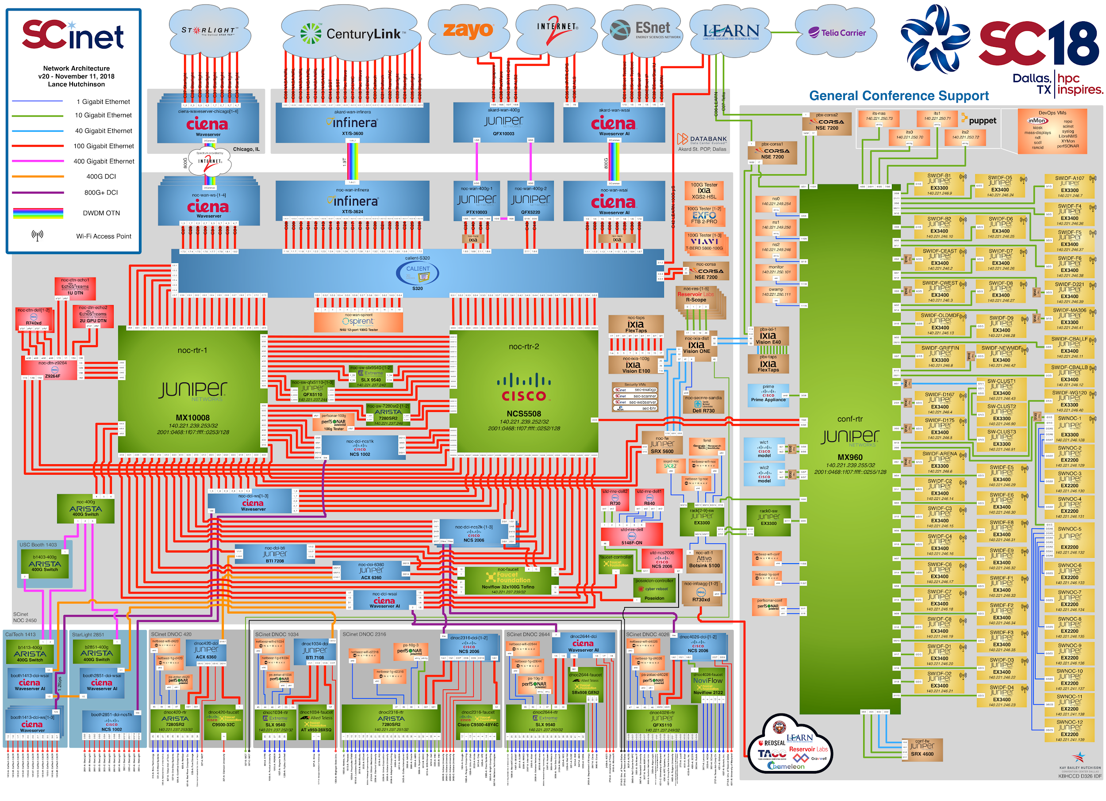
Notes:
Conference and exhibition network for SC18, Dallas, Texas
4.02 terrabit connectivity
US$52million in hardware
225 volunteers

Slide 11
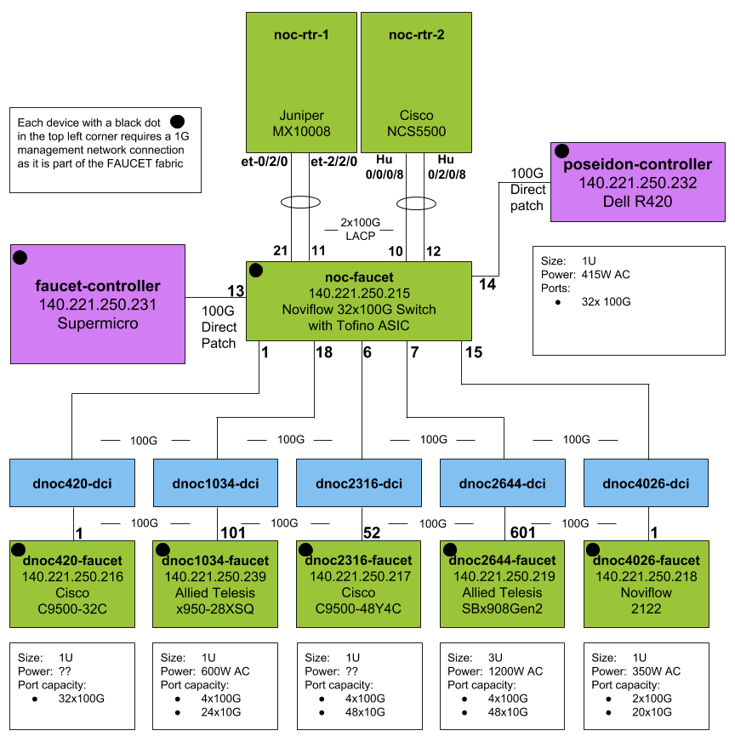
https://github.com/wandsdn/sc18-ansible
Notes:
https://github.com/wandsdn/sc18-ansible

Slide 12
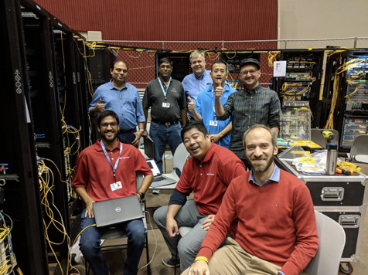
Staging and Testing
Notes:
What was easy - SDN
network was staged and booted with no issues
automation - import from database, ran scripts and configurations downloaded

Slide 13
Show Setup
Notes:
What was hard - building the network
running fibre on a concrete floor when people are driving forklifts and cherry pickers to build booths
something you only do if you absolutely have to.
Mismatched optics and wrong gear in booths.

Slide 14
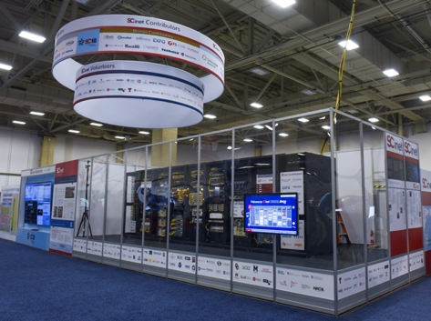
Complete NOC
Notes:
●Automating the network services that 90% of customers use helped operators have more time to spend working on the interesting 10% of customers
●Faucet allowed us to effectively ignore the underlying network equipment
●Proved 10,000 lines of python can easily handle many terabit/s

Slide 15
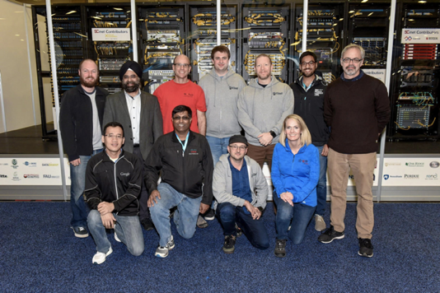
Team

Slide 16
Faucet, Multivendor 100G SDN Made
(fairly) Easy
Learn more http://faucet.nz
Follow us on Twitter @faucetsdn

