Slide 1
Solving DDoS Attacks
in the Netherlands
, europe
, and beyond
facilitating bridging solutions and stakeholders
Ddos clearing house
2019-05-21
Notes:
Welcome everyone to this presentation about @ Solving DDoS attacks. @ In the Netherlands @ Europe, @ And beyond @ Facilitating bridging solutions and stakeholders @ and DDoS Clearing House @ That’s quite a mouthful, so I’ll just refer to it as @ solving DDoS attacks

Slide 2
Solving DDoS Attacks
Koen van Hove
Researcher at the University of Twente
Notes:
my name is Koen van Hove, I’m a researcher at the University of Twente. I will be replacing Jair today as he is currently expecting his first child.

Slide 3
The problem and our idea
Notes:
Now, let me first explain the problem and our idea in broad terms.

Slide 4
https://www.business.com/categories/best-ddos-protection-services/
Notes:
By show of hands, is anyone from these companies in the room? – Yes, thank you very much, you have been doing an amazing job so far.

Slide 5
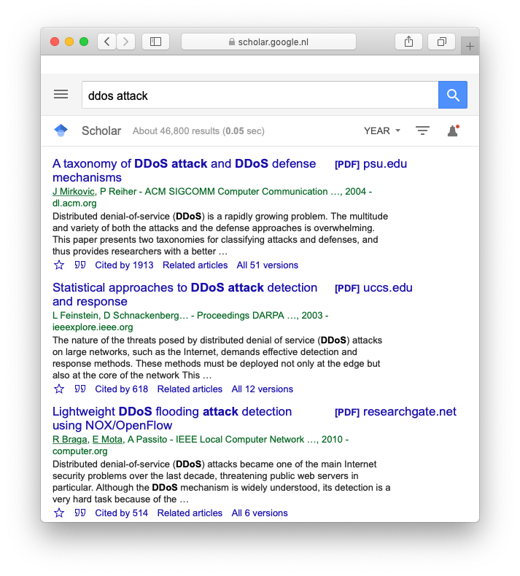
https://scholar.google.nl/scholar?hl=en&as_sdt=0%2C5&q=ddos+attack&btnG=
Notes:
Now, I am from academia, and a quick look on Google Scholar shows that there are over 40 thousand results when looking for DDoS attacks. So, we have the infrastructure and, we have the research, so

Slide 6
?
?
?
?
?
?
?
?
Why does DDoS still exist?
Notes:
@ “why does ddos still exist?”

Slide 7
Solving DDoS Attacks
Notes:
What we aim to do solving DDoS attacks is bridging the gap, @ bridging the gap between DDoS protection providers and academia.

Slide 8
Solving DDoS Attacks
DDoS
protection
providers
Academia
Notes:
@ Now, while the protection providers and academia are key to solving the problem, the DDoS protection providers and and academia aren’t the only stakeholders when it comes to DDoS attacks. We identify five different stakeholders, mainly

Slide 9
Network
operators
+
CERT/CSIRT
DDoS
protection
providers
Law
enforcement
agencies
Victims
Academia
Notes:
victims, DDoS protection providers, Network operators/emergency response teams, law enforcement and academia. To satisfy the needs of all these stakeholders, we create

Slide 10
Ddos clearing house
Notes:
the DDoS clearing house.
The DDoS Clearing House consists of

Slide 11
Ddos clearing house
Notes:
@ four technical components, and one crucial component to make it work: collaboration.

Slide 12
Network Measurement
(pcap, net flow, ipfix, sflow, logs, …)
DDoS_Dissector
input: network measurement
Output: DDoS fingerprint (+*NOTES)
filtered & anonymized network measUrements
DDoS_Fingerprint_converters
input: ddos fingerprint
Output: rule/signature for specific hw/sw solution(s)
(SNORT, SURICATA, BRO, IPtables, ebpf, bgp flowspec, …)
DDoSDB
STORE, enrich, and distribute DDoS attack related info
Notes:
But first, the technical components. The first part is the network measurement. We need some information about the incoming traffic. This can be a packet capture, a network flow, or something else that tells us something about the incoming traffic. Generally speaking, the more detailed the information is, the better the resulting analysis will be. @ Then we have what we call the “DDoS dissector”. This is a system that takes whatever network measurement you have, analyses it in the way a network administrator would, and then outputs the defining characteristics of the attack in what we call a fingerprint. Once we have that fingerprint, we can extract the attack from the network measurement by filtering on the characteristics in the fingerprint. Some information is of no use to us, but can be potentially sensitive, such as the destination IP, which we will hence remove from the capture. @ Now that we have that fingerprint, we can also convert that to whatever firewall rule we need. It is a relatively simple rule system. @ And last but not least there is DDoSDB, which is the central sharing platform for these anonymised network measurements. This way every time a new attack gets detected, a solution is immediately available from the community.

Slide 13
Network
operators
+
CERT/CSIRT
DDoS
protection
providers
Law
enforcement
agencies
Victims
Academia
Notes:
@ All of these stakeholders share a common goal: Stopping DDoS attacks. However, none of these stakeholders can do it on their own. @ They need each other. The DDoS clearing house and DDoSDB facilitate this cooperation.`

Slide 14
Notes:
@ Let me give an example of how it works. Let’s say we are under attack, and we capture all incoming packets. We then find out that there is a lot of UDP traffic coming over port 53. Looking closer, we can see that it is actually a DNS flood attack, where the attacker asks a DNS server to send the response to the victim. Our analysis will notice that, and extract “UDP, source port 53 with the DNS protocol from IP addresses x, y, z.”
@ We can then filter the packet capture with those characteristics, extract them, and anonymize the information we do not need (like zeroing out the destination IP and MAC), and upload them to DDoSDB. @ From the information in DDoSDB, other users can create a firewall rule.

Slide 15
Notes:
Now, let us zoom in on the grey cloud. @ The same DDoS attack to blue is coming in. However, because it is now already protected against this attack, @ the DDoS attack will fail.

Slide 16
Network
operators
+
CERT/CSIRT
DDoS
protection
providers
Law
enforcement
agencies
Victims
Academia
Notes:
@ So now we have satisfied the needs of the victim and network operator, because the attack was stopped, of the DDoS protection provider, because they know how to stop the attack. That leaves the CERT, Law enforcement agencies and academia.

Slide 17
Notes:
@ However, if we go back to the DDoSDB, the emergency response team can see that an attack stems from their network, and can hence find and resolve the problem.

Slide 18
Network
operators
+
CERT/CSIRT
DDoS
protection
providers
Law
enforcement
agencies
Victims
Academia
Notes:
@ So that is CERT now covered as well.

Slide 19
Notes:
@ Now, law enforcement can analyse the attacks that were uploaded to DDoSDB. It can compare them, and check how similar they are to find patterns. Then they just need to know the person behind one attack to know the person behind all attacks.

Slide 20
Network
operators
+
CERT/CSIRT
DDoS
protection
providers
Law
enforcement
agencies
Victims
Academia
Notes:
@ So that checks off law enforcement, meaning only academia is left.

Slide 21
Notes:
@ For the analysis of DDoS attacks, you need, well, DDoS attacks. That is what DDoSDB provides,

Slide 22
Network
operators
+
CERT/CSIRT
DDoS
protection
providers
Law
enforcement
agencies
Victims
Academia
Notes:
and hence academia @ is ticked. Now, is there anyone in the room who feels their role is not covered yet? (Raise hands)

Slide 23
One extra element…
Notes:
Okay, lastly

Slide 24
DDoS Open Threat Signaling (dots) [ietf]
Notes:
the Internet Engineering Task Force is working on a draft called “DOTS”, which will allow someone who’s under attack to signal that to the upstream provider, @ who can then block the attack.

Slide 25
DDoS Open Threat Signaling (dots) [ietf]

Slide 26
Demo:
Using the ddos dissector

Slide 27
Demo:
Querying ddosdb

Slide 28
[the current]
deployment & governance

Slide 29
Timelime
2019
2018
?
2017
Notes:
@ Where we currently stand. In 2017, the DDoSDB project was started by the University of Twente and SIDNfonds. In 2018 it was expanded to the Dutch government, nationale beheersorganisatie internet providers, KPN, ING and others. In 2019, we intend to expand to a European level.

Slide 30
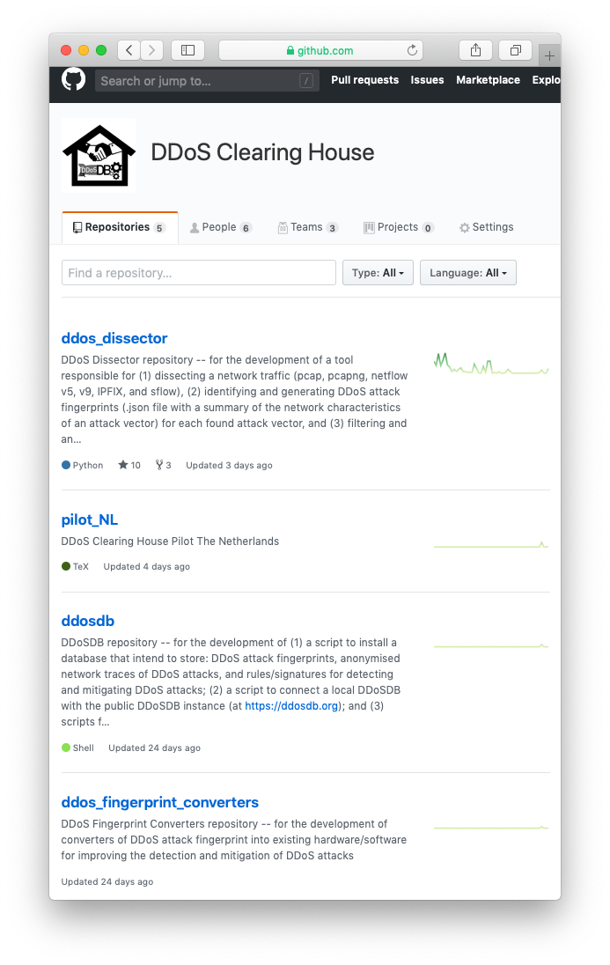
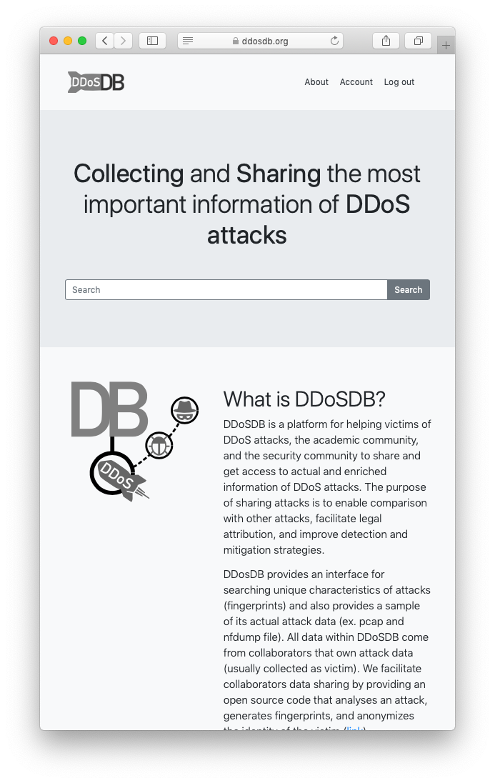
https://github.com/ddos-clearing-house
https://ddosdb.ORG
https://ddosdb.NL
Notes:
@ All progress can be found on github, the DDoSDB website can be found on ddosdb.org. Now, there is also a more private DDoSDB instance, in case you don’t want to share it with everyone.

Slide 31
challenges &
future directions
Notes:
@ Here we can see a possible overview of interaction with different DDoSDB instances.

Slide 32
.org
.nl
Notes:
However, how we want to do that is yet to be determined @ we might have that structure, or @ a more centralised structure.

Slide 33
.org
.nl
.it

Slide 34
Questions?
Solving DDoS Attacks
Koen van Hove
Researcher at the University of Twente
koen@ddosdb.org

Slide 35
BACKUP SLIDES

Slide 36
Network Measurement
(pcap, net flow, ipfix, sflow, logs, …)
DDoS_Dissector
input: network measurement
Output: DDoS fingerprint (+*NOTES)
filtered and anonymized netw. measU.
DDoS_Fingerprint_converters
input: ddos fingerprint
Output: rule/signature for specific hw/sw solution(s)
(SNORT, SURICATA, BRO, IPtables, ebpf, bgp flowspec, …)
DDoSDB
STORE, enrich, and distribute DDoS attack related info

Slide 37
Solving DDoS Attacks
in the Netherlands, Europe, and Beyond
facilitating bridging solutions and stakeholders
Ddos clearing house
3/03/2019

Slide 38
WHAT IS THE AVERAGE ECONOMIC LOSS PER DDOS ATTACK?
A. $25.000
C. $2.500.000
https://www.zdnet.com/article/the-average-ddos-attack-cost-for-businesses-rises-to-over-2-5m/
B. $250.000
D. $25.000.000

